Slide 1
Getting Started with Maven
By Srikrishna.

Slide 2
Agenda
Things we are going to cover
What is Maven…?
What is Software Building…?
POM
Maven Architecture
Dependency Management
Deep diving into Maven

Slide 3
This is a training NOT a presentation
Please ask questions
Few Notes Before starting the session
Prerequisites
- Introduction to the Java Stack
- Basic Java and XML skillz
- Experience with IDE
- Compile and Run java program from command line

Slide 4
Let’s get straight into business…
What is Maven…?

Slide 5
Answer Depends on you and your use case…

Slide 6
Build Systems or Build Tools
Compile Source Code
Compile and Run Unit Test
Deploy Project
S
T
D
R
P
C
Package Project
Cleanup
Copy Resources

Slide 7
IDE VS Build Tools

Slide 8
Maven Architecture
Plugin 1
Plugin 2
Plugin 3
Plugin N
Maven Core Engine
R 1
R N
L
Remote Repo
Local Repo

Slide 9
What Maven Offers for Us…?
POM
Uniform Project Structure
Dependancy Management
Convention Over Configuration
Multi Module Projects
Java Doc Generation
Site Generation

Slide 10
POM
G
B
General Project Information
General Information
Build Settings
Includes project names, project urls, company details, developers and license and so on….
Build Settings
Defines custom behavior for default maven build. We can change project structure, lifecycle, plugins and site generation.
Build Environment
POM Relationship
Build Environment
The build environment consists of profiles that can be activated for use in different environments for different needs and purpose
POM Relationships
E
R
A project rarely stands alone; it depends on other projects, inherits POM settings from parent projects, defines its own coordinates, and may include sub modules.

Slide 11
POM
POM
1
2
3
Super Pom
Simplest Pom
Effective Pom
All Maven project POMs extend the Super POM, which defines a set of defaults shared by all projects.
Simple project POM defines nothing but maven coordinates
Super POM + POM = Effective POM

Slide 12
Dependency Resolution

My PC 1



My PC 2
Remote Repo
Central Repo

My PC 3

Slide 13
Its Time for Playground
Lets get our hand dirty

Slide 14
Maven Lifecycles

Slide 15
Maven Default Lifecycle
Process Resource
Install
resources:resources
install:install
1
6
2
Compile
7
Deploy
:compiler:compile
5
deploy:deploy
Package
Start Here
jar:jar
3
Final
Process Test Resources
4
:resources:testResources
Test Compile
surefire:test

Slide 16
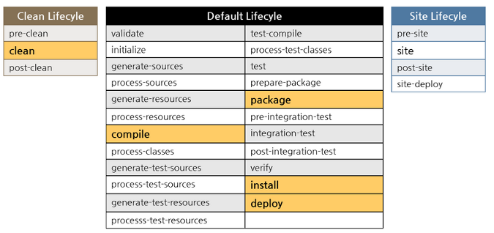

Slide 17
Dependency Management
And what it is…?

Slide 18
Dependency Scope
C
Compile
This is the default scope, used if none is specified. Compile dependencies are available in all classpaths of a project. Furthermore, those dependencies are propagated to dependent projects.
P
Provided
This is much like compile, but indicates you expect the JDK or a container to provide the dependency at runtime. For example, when building a web application for the Java Enterprise Edition, you would set the dependency on the Servlet API and related Java EE APIs to scope provided because the web container provides those classes.
R
Runtime
This scope indicates that the dependency is not required for compilation, but is for execution. It is in the runtime and test classpaths, but not the compile classpath.
T
Test
This scope indicates that the dependency is not required for normal use of the application, and is only available for the test compilation and execution phases.
S
System
This scope is similar to provided except that you have to provide the JAR which contains it explicitly. The artifact is always available and is not looked up in a repository

Slide 19
<dependencies>
<dependency>
<groupId>group-a</groupId>
<artifactId>artifact-a</artifactId>
<version>1.0</version>
<type>jar</type>
<scope>compile</scope>
<optional>true</optional>
<systemPath>${java.home}/lib/rt.jar</systemPath>
<exclusions>
<exclusion>
<groupId>group-c</groupId>
<artifactId>excluded-artifact</artifactId>
</exclusion>
</exclusions>
</dependency>
</dependencies>

Slide 20
<dependencies>
<dependency>
<groupId>group-a</groupId>
<artifactId>artifact-a</artifactId>
<version>1.0</version>
<type>jar</type>
<scope>compile</scope>
</dependency>
</dependencies>

Slide 21
Little Quiz…!
Parent POM
Child POM
<dependencies>
<dependency>
<groupId>group-a</groupId>
<artifactId>artifact-a</artifactId>
<version>1.0</version>
</dependency>
</dependencies>
<dependencies>
<dependency>
<groupId>group-a</groupId>
<artifactId>artifact-b</artifactId>
<version>1.0</version>
</dependency>
</dependencies>
What dependencies will be in effective POM…?

Slide 22
Little Quiz…!
My POM
group-a:artifact-a:1.0.jar
<dependencies>
<dependency>
<groupId>group-b</groupId>
<artifactId>artifact-a</artifactId>
<version>1.0</version>
</dependency>
<dependency>
<groupId>group-b</groupId>
<artifactId>artifact-b</artifactId>
<version>1.0</version>
</dependency>
</dependencies>
<dependencies>
<dependency>
<groupId>group-a</groupId>
<artifactId>artifact-a</artifactId>
<version>1.0</version>
</dependency>
</dependencies>
What dependencies will be in effective POM…?

Slide 23
How about grouping related dependencies into single POM…?

Slide 24
Optional Dependencies and Dependency Exclusions

Slide 25

Thank You For Lıstenıng
I’ll be answerıng questıons now
Fell free to say hi! If you have any doubts
Email: srikrishna.sekar@...
Spark: ssrikrishna

